Slide 1
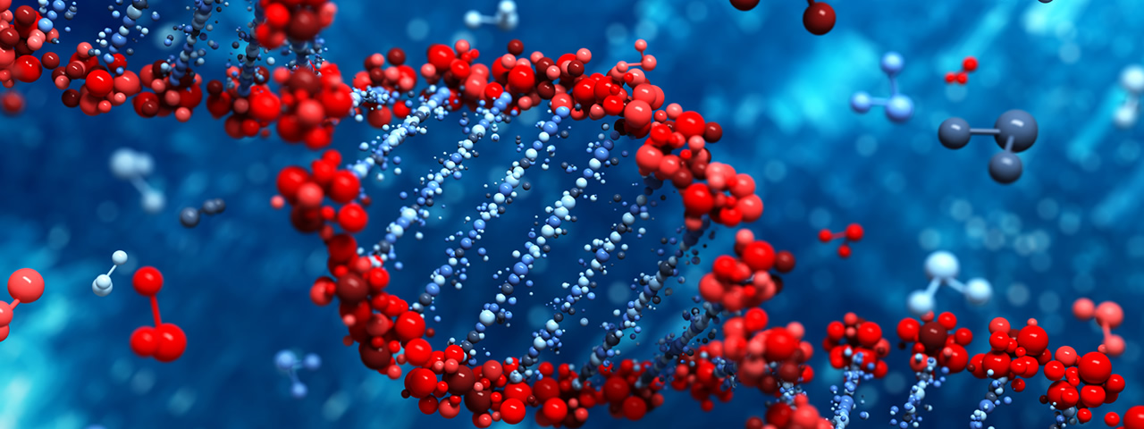
Biomolecules
April 2022

Slide 2
Biochemistry
The study of the chemistry occurring in living organisms
Biomolecules = macromolecules
Very large molecules consisting of smaller, simpler molecules linked together.
Major chemical components of cells:
Lipids
Carbohydrates
Proteins
Nucleic acids

Slide 3
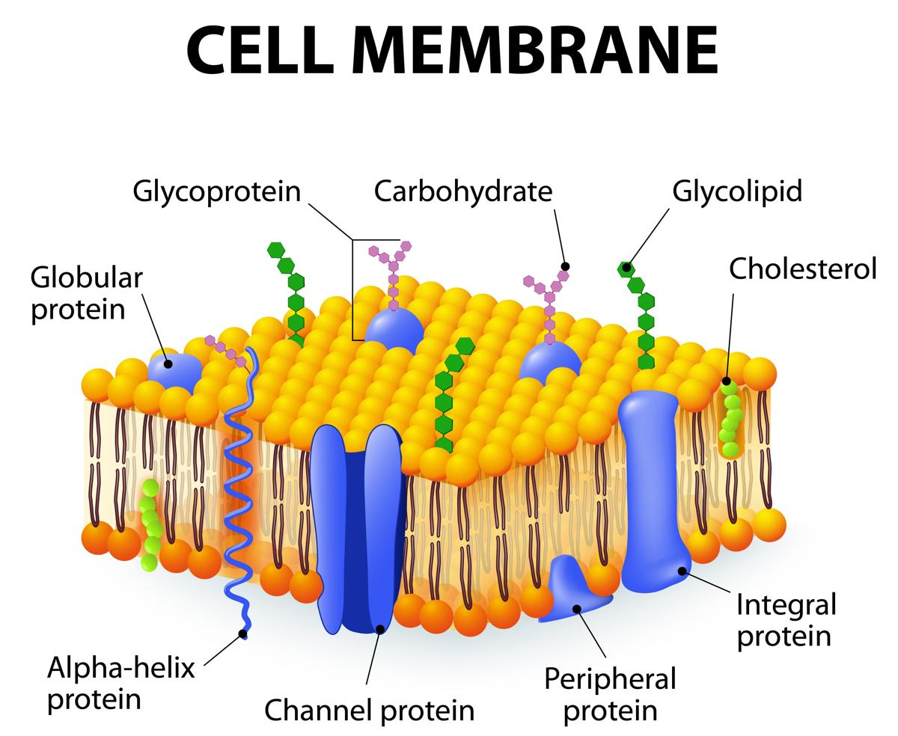
Lipids
Chemical components of the cell that are insoluble in water but soluble in nonpolar solvents.
Insolubility in water makes them ideal as structural components of cell membranes.
Lipids are also used for long-term energy storage and for insulation
Fatty acids – Fats – Oils – Phospholipids – Glycolipids - Steroids

Slide 4
Lipids: Fatty acids
Name | Number of C’s | Sources
Butyric acid | 4 | Milk fat
Caproic acid | 10 | Milk fat, whale oil
Myristic acid | 14 | Butterfat, coconut oil
Palmitic acid | 16 | Beef fat, butterfat
Stearic acid | 18 | Beef fat, butterfat
Oleic acid | 18 | Olive oil, peanut oil
Linoleic acid | 18 | Linseed oil, corn oil
A fatty acid is a carboxylic acid with a long hydrocarbon tail.
The hydrocarbon tail must contain from 3-19 carbons.

Slide 5
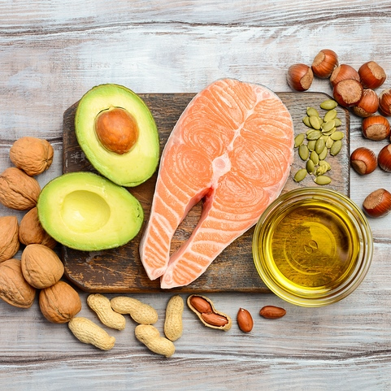
Lipids: Fatty acids
Fatty acids are found in oils and other fats that make up different foods.
Needed for:
Moving O₂ through the bloodstream to all parts of the body.
Cell membrane development, strength and function.
Strong organs and tissues.
Fatty acids can also help keep skin healthy, help prevent early aging, and may promote weight loss by helping the body process cholesterol.
Another purpose of fatty acids is to assist the adrenal and thyroid glands, which may also help regulate weight.

Slide 6
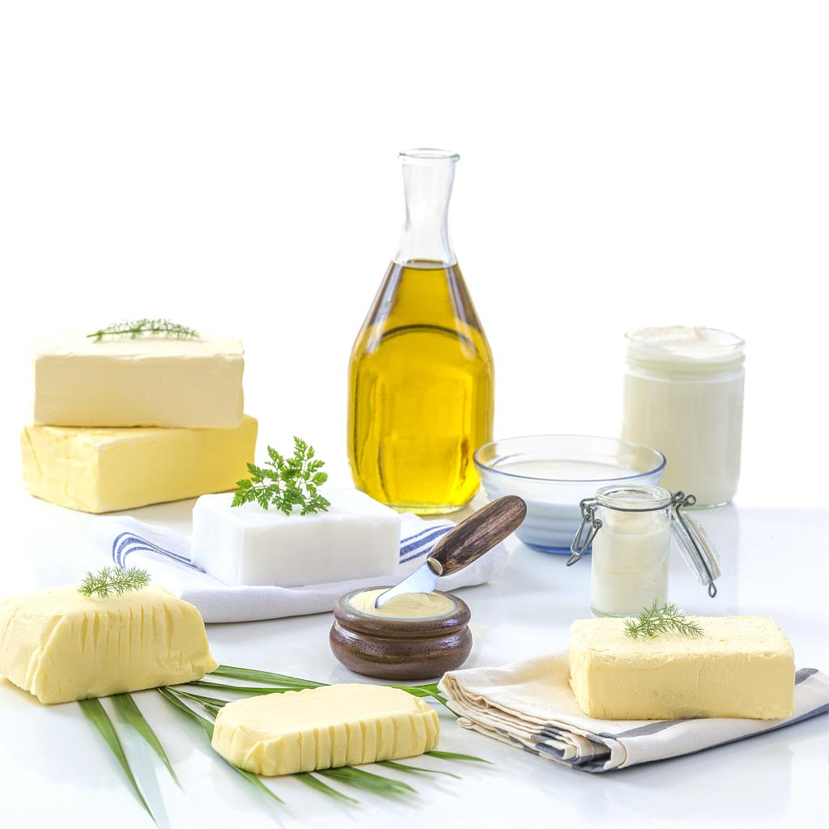
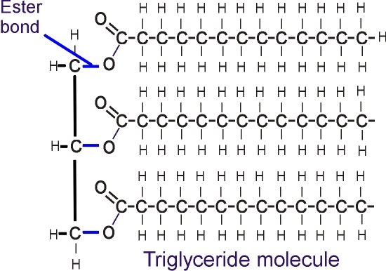
Lipids: fats and oils
Fats and oils are triglycerides (triesters)

Slide 7
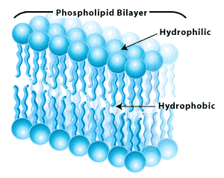
Other lipids
Other lipids found in cells include phospholipids, glycolipids and steroids
Phospholipids have the same structure as triglycerides, except that it is replaced by a phosphate group.
Polar part:
phosphate groups
Nonpolar part:
hydrocarbon chain

Slide 8
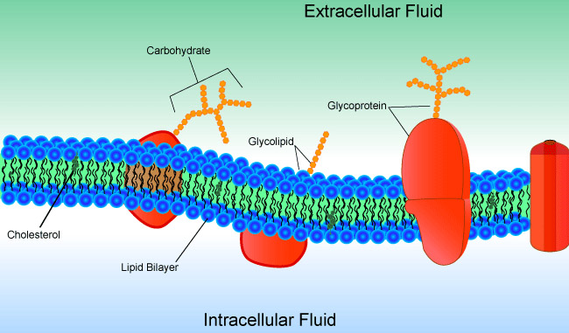
Other lipids: Glycolipids
Glycolipids also have a polar and nonpolar part.
Polar part: sugar molecule as glucose
Nonpolar part: hydrocarbon chain.

Slide 9
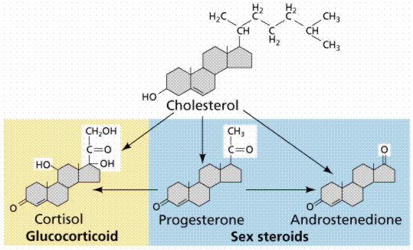
Other lipids: Steroids
Steroid are lipids with the following four ring structure.
Some common steroids are
cholesterol
testosterone
B-estradiol

Slide 10
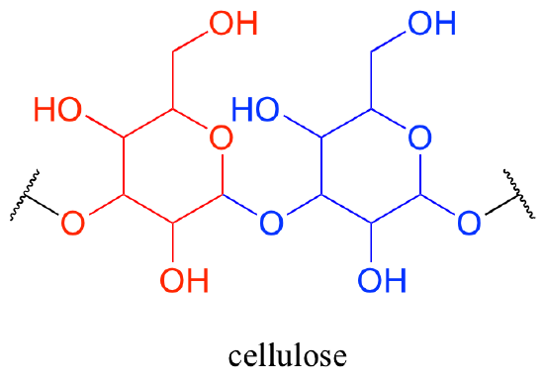
Carbohydrates
Responsible for short term storage of energy in living organisms.
Make up the main structural components of plants
Made up of C, H and O: they are polyhydroxy aldehydes or ketones.

Slide 11
Complex carbohydrates
Simple sugars are called mono-saccharides. When they join, they are called polysaccharides.
Polysaccharides are called complex carbohydrates.
Cellulose
Starch
Glycogen
The difference between them is how they are bonded together.

Slide 12

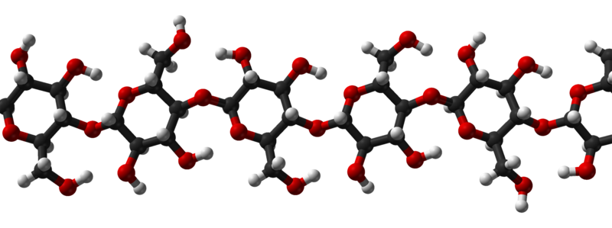
Cellulose
Main structural component of plants
Most abundant organic substance on Earth.
Can be structural material since they can hydrogen bond many, many, many times → wood and fiber.
A special enzyme is needed to digest it. Humans don’t have it.

Slide 13
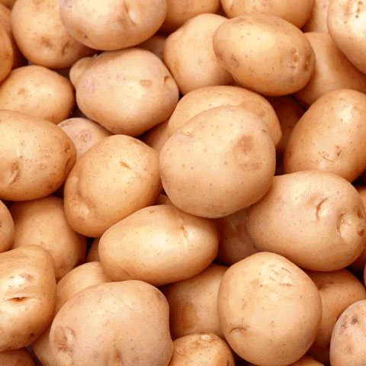
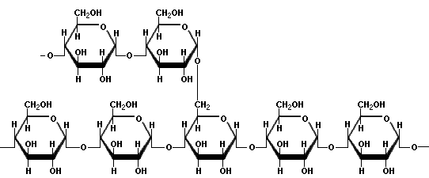
Starch
Main energy storage for plants
Found in potatoes and starch
Made up of two polysaccharides: amylose and amylopectin
Glucose units bonded together
When we digest it, those bonds are broken and glucose units can pass through the intestine walls and then the bloodstream.

Slide 14
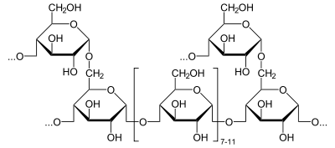
Glycogen
http://www.youtube.com/watch?v=BwpNJSeNYqI&feature=related
Similar structure to amylopectin, but more highly branched.
Animals use glycogens to store glucose in the muscles.
When there is no glycogen, muscle movement and exercise become much more difficult.

